Slide 1
Introduction to Iterables: Strings
Session Four
Notes:
Welcome to our fourth session! Today we’ll be covering a handful of topics. In particular, we’re going to start with a new data type - strings! For the infosec topic we will build on the PIRs we learned about last week and take on intel writing.

Slide 2
Reminders
Due Today
Due Next Week
Homework from Session Three
Quiz on Sessions Two & Three Content
Homework from this session
Quiz on this session’s content
Notes:
As some quick reminders before we get into things, today we’re going to have your first real quiz and your homework is due.

Slide 3
Reminders
Due Today
Due Next Week
Homework from Session Three
Quiz on Session Three Content
Homework from this session
Quiz on this session’s content
Notes:
Next week we will have a quiz and a homework due. We will also have our first guest speaker so please brainstorm questions you might want to ask related to investigations into human trafficking or information operations.

Slide 4
Agenda / Topics
1. Start of Class & Quiz
2. Strings Concept & Syntax
3. [Start:STop:STEP] & first functions & Methods
4. Break
5. Security Topic
6. Overflow / Q&A / Dismissal
6:30 - 7:00
7:00 - 7:45
7:45 - 8:00
8:00 - 8:15
8:15 - 8:45
8:45 - 9:00
Notes:
Today we’ll have a q&a to answer any last-minute burning questions from last week and then we’ll be doing the practice quiz. After that, we’ll start the lecture. We’ll cover a handful of topics with a break at 8 pm and we’ll wrap the class up before 9 pm.

Slide 5
Q&A
?
Notes:
Any last-minute questions before the quiz?

Slide 6

Quiz
Access the quiz here: https://forms.gle/xYsYFWH6zeMzQxxx7
Screenshot before submitting & don’t refresh.
Notes:
Alright! Here’s the quiz. Please remember to screenshot or otherwise record your answers before you hit submit and don’t refresh! Google forms will drop your answers if your connection drops. https://forms.gle/xYsYFWH6zeMzQxxx7

Slide 7
Follow-up on last week’s material:
TTPS, IOCs, and defanging

Slide 8
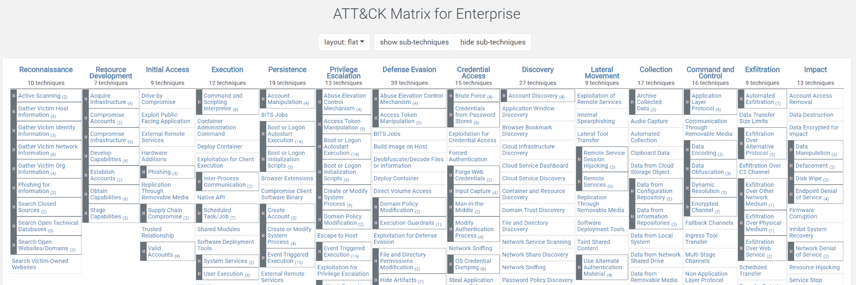
Tactics, Techniques, and Procedures (TTPs)
Tactics, Techniques, and Procedures = TTPs
Term used to refer to the behavior of an actor.
A tactic is the highest-level description of this behavior
Techniques give a more detailed description of behavior in the context of a tactic
And procedures an even lower-level, highly detailed description in the context of a technique.
Notes:
In the homework this week I saw that many people were conflating two terms IOCs and TTPs. I realize this is reasonable because we never taught you what a TTP is so I am adding it at the top of class this week. I do want to encourage everyone though in class to please ping into the chat or unmute and ask a question if we use a term with which you are not familiar. I did use TTP multiple times during class and it would have been helpful to everyone if you heard this term and didn’t recognize it if you had called me out for using a term which we hadn’t defined as a class. So don’t hesitate to do so - this homework exercise demonstrated that you would not have been alone in needing that definition.
TTP stands for tactics, techniques, and procedures but you will almost always hear just the acronym. TTPs is a term used to refer to the behavior of an actor. While each word does technically have a unique definition:
A tactic is the highest-level description of this behavior
Techniques give a more detailed description of behavior in the context of a tactic
And procedures an even lower-level, highly detailed description in the context of a technique.
Most people in the private sector cybersecurity world just refer to all three collectively as TTPs. It is rare to hear someone say “this is the procedure the actor used to gain access to the system” and more common to hear someone ask “What TTPs were used by the actor?”
In the second class we covered the ATT&CK Matrix and I explained that this framework categorizes and enumerates the possible TTPs an actor can use at each stage of an attack. I highly recommend going back now and reading through some of the items in this framework which should give you a good sense for the possible TTPs which an actor might use as part of an attack.

Slide 9
TTPs vs IOCs
Indicators of compromise = iocs
Tactics, techniques, and procedures = ttps
TTP Examples
IOC Examples
IOCs are the technical artifacts which are related to specific malicious activity.
TTPs are the behaviors of an actor.
Phishing email sent
Supply chain compromise
Brute force password guessing
Man-in-the-middle
Exfiltration over physical medium
Exfiltration over web service
Email addresses
IP addresses
Malware hashes
Domains and URLs
Phone numbers
Notes:
TTPs are the behaviors of an actors; whereas, IOCs are the technical artifacts which are related to specific malicious activity. So if I ask you for TTPs I would expect to see a list of email addresses, IP addresses, domains, etc. Whereas, if I ask you to describe the TTPs which an actor leveraged in a given attack I would expect you to be able to describe that the actor sent phishing emails containing a malicious attachment.

Slide 10
Defanging iocs
IP Address defanging
domain/url Defanging
Email defanging
Malware hashes
Defanging IOCs = making the IOCs safe to share by ensuring that no one, yourself included, who interacts with them will inadvertently click on the IOC.
Put brackets around every period in the IP address.
1[.]1[.]1[.]1
Replace the ts in http or https with xs and put brackets around the periods.
hxxps://www[.]evilwebsite[.]edu
www[.]reallybadtoclickon[.]com
Put brackets around the @ and around the period in the domain.
lbh22[@]georgetown[.]edu
Do not need to be defanged because the hash is just a unique representation of the file; it is not the file itself so having malware hashes on your machine is not a problem and clicking on them isn’t an issue.
Notes:
The homework was so helpful in revealing to me that we need to cover another topic - defanging IOCs! IOCs are by definition potentially malicious. Therefore, it is inadvisable to directly interact with them. To foot stomp this YOU SHOULD NOT CLICK ON IOCs because they could lead you to dangerous places on the internet.
Defanging IOCs is the process by which you make IOCs safe to share by ensuring that no one, yourself included, who interacts with them will inadvertently click on the IOC and go somewhere malicious. So the way we defang an IP address is to put brackets around every period in the IP address. For domains and urls (and anywhere they show up such as in email addresses) we put brackets around the periods and then we replace the ts in http(s) with xs. Meaning we write hxxps://www[.]google[.]com. For email addresses I have never known what precisely is the standard but I put brackets around the @ in addition to around the period in the domain.
Finally, I know we haven’t done a deep explainer on what malware hashes are yet but just know that you do not need to defang malware hashes. This is because the hash is a unique representation of the malware file but it is not the file itself so having malware hashes on your machine is not a problem and clicking on them isn’t an issue. Nothing will happen.

Slide 11
REPEAT AFTER ME -
I WILL NOT CLICK ON IOCS
I WILL ONLY WORK WITH DEFANGED IOCS
I WILL NOT DOWNLOAD MALWARE FILES, i WILL WORK WITH HASHES

Slide 12
strings

Slide 13
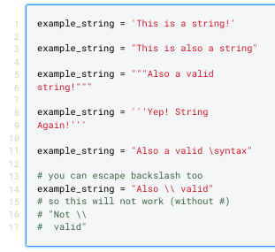
Strings
Strings are Python’s way of representing text data.
Any consistent quotation marks around characters declares a string
Triple of any quotation marks declares a multi-line string
You can use backslash to split lines too (an extra backslash also escapes this rule)

Slide 14
STrings Practice
Write a string that contains a sentence about yourself.
Use single quotation marks
Use double quotation marks
Make it spread over multiple lines
Use triple quotation marks
Use backslash
Put a backslash in your text and make sure it doesn’t split the line when printed
Make sure to store your sentence in variables and print them by calling print on your variable.
Example:
a = ‘This is an example sentence for a’
print(a)
Let’s make some strings! Try this on your own after class.

Slide 15
New Type
Type | Examples | Properties / Description
Integer int(x) | -1 0 1 | Integer whole numbers that you can use in mathematical operations
Floating Point float(x) | -1.0 0.0 1.0 | Decimal-point precision real numbers that you can use in mathematical operations
String str(x) | “Example” “1.0” | Sequence of text characters, cannot be used in mathematical operations

Slide 16
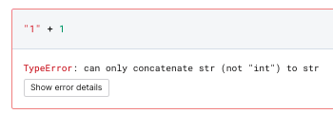
Casting / Conversion
Python will not implicitly convert strings to integers or floats and will not implicitly convert integers or floats to strings.
Incompatible types for implicit conversion.

Slide 17
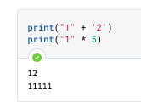

Math with STrings
The + operator is “overloaded”* to support strings. For strings, + means concatenation.
The * operator will make the specified number of the character specified.
Some operations work but not in the way you might expect.
* Python doesn’t have overloading

Slide 18
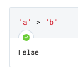
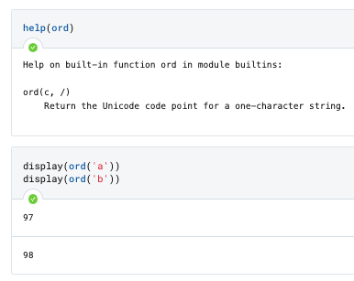

Comparison with Strings
Some operations work but not in the way you might expect due to how characters are backed by numeric unicode values. Convert between ordinal and character values with ord() and chr().
Notes:
If you try to compare two strings, you may be surprised to find out that this is a valid operation. If you test out a few letters, your initial assumption might be that Python treats letters further in the alphabet as “higher value” - and you’d be partially correct.
What is happening under the hood is that all characters - letters, numbers, other symbols, letters in other languages - all of them have assigned ordinal values. For example, above we can see that ‘a’ and ‘b’ are 97 and 98. The letter в in Russian is 1074. A semicolon is 59 and the number zero, as a character and not as an integer or float, is 48.
These values are based on unicode. Unicode is “an international encoding standard for use with different languages and scripts, by which each letter, digit, or symbol is assigned a unique numeric value that applies across different platforms and programs.” (Oxford).
You an convert between the ordinal value that backs a character by using the methods ord() (which gives the ordinal/numeric value) and chr() (which is read as “char”, and produces the character that corresponds to a particular ordinal value).

Slide 19
Quick Quiz
What’s the data type?
“1”
“One”
2
4.4
“4.4”
0
“float(1) + 0”
str(1) * int(5.5)
Data Types

Slide 20
Strings
Python statement | x = “Example”
breakdown | x (variable name) |  |  | = (assignment operator) |  |  | “Example” (string object)
String object:
Intro to Iterables
Contents | E | x | a | m | p | l | e
Index: | 0 | 1 | 2 | 3 | 4 | 5 | 6

Slide 21
Intro to Iterables
“ | E | x | a | m | p | l | e | “
Index: | 0 | 1 | 2 | 3 | 4 | 5 | 6
Strings are sequences of characters.
ORDER MATTERS: As a sequence, they are ordered. There are ways to access each character by its position in the ordered sequence.
NOT NUMBERS: Everything in a string is a character. This means that numbers, for example, do not have mathematical meaning.
NOT CODE: Similarly, Python punctuation marks and other structures that are within a string are not interpreted as code.
INDEXING: Indexing starts at zero (“zeroeth index”). The “first” item in an iterable is the item at the first index, not the zeroeth.

Slide 22
Index Access & [Start:Stop:Step]
You can access the value at any given index in a string using the syntax [start:stop:step] after the string. Let’s look at an example and then we’ll break it down.
Let’s say:
x = “Example”
Let’s try a few challenges.
Ready?
 | E | x | a | m | p | l | e
Index: | 0 | 1 | 2 | 3 | 4 | 5 | 6

Slide 23
Index Access & [Start:Stop:Step]:
Getting a single item
You can access the value at any given index in a string using the syntax [index] after a string.
“example”[0] # this will give you the zeroeth item, “e”
“example”[1] # this will give the first item, “x”
“example”[6] # this will give you the six item, “e”
We can also do this with our variable that contains our string example (x) like:
x[0]
You can also use negative indexes to grab from the back of the string.
“example”[-2] # this will give “l”
This is the same as:
x[-2]
“Example”[-1]
x[-1]
→ “l”
“ | E | x | a | m | p | l | e | “
Index: | 0 | 1 | 2 | 3 | 4 | 5 | 6
 |  |  |  |  |  | (index)

Slide 24
Practice Getting Specific Indices
Mechanical Practice Problems | Creative Practice Problems
Given: x = “This is a test!” Get: The first index The last index The third to last index | You’re grading homework turned in by students who filled out true/false problems. You want to automate this so you don’t have to do it by hand. This should be easy since the answer to every problem was true! Given student answers, write code that, if applied against every line, could check if they were right or not. You can assume you already have code to apply your logic against each assignment and problem and to handle the conditional logic around “if this do that”. Just write the code to determine if their answer was true or false. Example assignment: true false false false

Slide 25
Index Access & [Start:Stop:Step]:
Getting a sequence (“Slice”)
If you need to access a sequence of values, you will need to add another parameter to our bracket.
The initial index we started at will become the START of the sequence. The second number will become the STOP. Python will return the start and everything up until (but not including) the stop. They are separated by a colon. This is called getting a slice.
“Example”[0:3] # this will get indexes zero (inclusive) up to three (exclusive) (so “Exa”)
This also works with negative values.
“Example”[0:-3] # this will get from zero -3, so (Eel)
You can shortcut the beginning or end of
the string by leaving them off.
“Example”[:4] # goes from beginning to 4th index
“Example”[2:] # goes from 2nd index to end
“example”[0:-3]
→ “eel”
“ | E | x | a | m | p | l | e | “
Index: | 0 | 1 | 2 | 3 | 4 | 5 | 6
 | (start) |  |  |  | (stop)

Slide 26
Every Other Character with [Start:Stop:Step]
[Start:Stop:Step] is the full form of the syntax and the most powerful (and often confusing) version. You can use it to do things like grab every nth character.
So, for example, say we want to access every other character from the beginning to the end of the string. This means we want to START at index zero. We want to STOP at index 6. And we want to STEP in increments of two (so we go every other character).
Here’s what this will look like in code.
x = “example”
x[0:6:2]
If we want to, we can allow the beginning
of the string and the end of the string to be
Implied. Here’s that syntax:
x = “example”
x[::2]
“example”[0:6:2]
“example”[::2]
→ “eape”
“ | E | x | a | m | p | l | e | “
Index: | 0 | 1 | 2 | 3 | 4 | 5 | 6
 | (start) (step) |  | (step) |  | (step) |  | (stop) (step)

Slide 27
Every Other Character with [Start:Stop:Step]
This also works with negative step values.
We want to START at index 6. We want to STOP at index zero. We want to STEP by two...but backwards.
“example”[0:6:-2]
“example”[::-2]
→ “epae”
“ | E | x | a | m | p | l | e | “
Index: | 0 | 1 | 2 | 3 | 4 | 5 | 6
 | (stop) (step) |  | (step) |  | (step) |  | (start) (step)

Slide 28
String-Specific Functions & Methods
There are many special things you can do with strings. For now, we’re only going to learn a few to use with our homework.
“Example”.lower() # this is the lower method.
# It only works on strings and makes everything lowercase.
“Example”.upper() # this is the upper method.
# It only works on strings and makes everything uppercase.
len(“Example”) # this is the length function.
# It will return the length of whatever you give it.
# this is a function and not a method - it works on any data type that has
# a length, not just strings. You’ll use this on more data types in the future.
“Example”.replace(“E”, “e”) # this will strip out a specified substring and replace with another

Slide 29
String-Specific Functions & Methods
Something important: lower and upper are both methods. We will cover these in more detail later. But for now, you should know that they modify the object they are called on. Neither of these methods changes the object they are called on permanently - but some methods we will see later will passively change their parent object.

Slide 30
Infosec Topic
Intelligence writing and the importance of delivering a good bottom line up front (BLUF)

Slide 31
Intelligence writing is not normal writing
Letter or essay style.
Red teaming exercises are important to our success in detecting APT intrusions. Specifically, we must prepare our SOC analysts to identify attacks to which our tooling alone will not alert us. Our analysts must learn to identify connections between alerts as opposed to just triaging each alert individually. They also need to know that this is an expectation of their job and not an optional approach to try only when we are exercising. If we engage the red team consistently then the SOC analysts will internalize this skill and be ready to identify real intrusions.
Memo style.
Red teaming exercises prepare SOC analysts to detect APT intrusions.
Greater than X% of sophisticated attacks are not detected by individual tools.
Analysts must identify connects in alerts across tools to identify sophisticated attacks.
Analysts cannot accomplish this by triaging individual alerts alone.
The business must set an expectation that all analysts seek to identify these connections in alerts across tools.
The business must create time during which analysts can conduct this work.
Red team exercises are one mechanism to provide analysts practice with this work.
Notes:
Intelligence writing is not meant to tell a story. It is meant to inform a decision. The practice of intelligence writing in the intelligence community is a highly structured endeavor with rigid style guides, templates, and manuals which dictate exactly how to use specific terminology and structure written content for maximum shared understanding of usage across all readers. In the private sector intelligence writing tends to be less formal and while we will not hold you to such a strict standard in this course it is helpful to understand the foundation of this writing style so that you can intentionally choose to depart from it as opposed to unknowingly bashing all of the norms and possibly leading to misunderstandings between yourself and the recipient.

Slide 32
Information vs intelligence
Information
A list of IOCs
A bunch of memes
A map
The address of the office out of which an APT actor works
A SIEM alert
Intelligence
A briefing which explains that a ransomware group responsible for X malware (see IOCs) has moved their office (at address on map) to a new city in Russia due to pressure from international sanctions which prevent them from traveling. They are sharing memes on X darkweb forum stating that they will not leave Ukraine because they are untouchable. We know they are now in Russia because each member’s cell phone is connecting to Russian IP Space prior to connecting to a VPN which routes them through Ukrainian IP space.
Notes:
Your main goal when you are writing an intelligence product is to convey insight which will enable a decision or drive a particular action. It is important to understand the difference between information and intelligence. Information underpins intelligence but is differentiated from intelligence in that it does not convey insight. For example, a particular malware hash or set of malware hashes and IP addresses are information. Alone they tell us very little. If you are my client and I just send you an email with a list of hashes and IPs in it this does very little if anything to help you secure your enterprise because they are devoid of context.
Intelligence pairs the information with the context to drive some level of insight which the information alone could not convey. For example, a briefing which explains that a Ukrainian ransomware gang has moved their operation to Russia likely in response to sanctions and that we are likely to see a shift in used infrastructure.

Slide 33
Raw intelligence
WIRE 9876 - FILE FOUND ON VT TARGETING PRIME MINISTER OF MALAYSIA
We had a YARA rule out looking for files related to APT999 that triggered on a file ‘so_hot_right_now[.]exe’; I looked into it briefly and it looks pretty typical for the malware family that we’ve previously tracked internally as ‘Derelicte’. The compilation date on the sample (09/10/21) is recent.
File: 1bd4f4743bed16314b32f828c23427ed
Notes:
As an individual working as part of a larger intelligence apparatus you may be responsible for producing or analyzing raw intelligence; it is one half step away from pure information in that it ostensibly has some connection to something you are interested in so has some limited context. Raw intelligence, sometimes consumed in a type of document called a “wire”, is content that is either generated from a machine or collected by a human being and recorded for analytic consumption, most commonly as a form of “lead”. The content will generally be written pretty quickly by individuals who are often hired for their specific subject matter expertise - whether that’s a technical skill like being able to scrape online forums or a human skill like speaking a specific regional language, having contacts into a specific organization, and so on. In the private sector today you will find collections specialists with a wide range of analytic skills. Some raw intelligence will come to you looking very similar to a full analytic product (the collector may have worked as an analyst previously); in some cases you may get content that has been google translated into English for submission. Raw intelligence is in many ways the wild west. The format will vary both from shop to shop and from collector to collector in some cases; and as an analyst, you should always be skeptical of data from a wire.
The aim of raw collection is generally different than almost every other kind of intelligence product. Most organizations that develop wires are after speed and access. If an event happens, they want to have had it covered. They want to produce as much unique, relevant raw content as possible. This is because not every piece of raw intelligence turns into an analytic product - and those that do sometimes are consumed in conjunction with others to get to a more full story.
Some shops do not have raw intelligence collection at all, preferring to have their analysts do all of the research and intelligence writing. For large-scale shops that specialize in writing intelligence, having a collections team to generate leads is a must - they have a higher quota expected of them to produce unique, original insights just to create product whether or not something important enough for any given leader is known. Smaller shops that do intelligence work as a by-product or as part of an otherwise dedicated security organization are far less likely to have dedicated collectors.

Slide 34
Guidelines for intelligence writing
Put your main point up front aka bottom line up front (BLUF)
Write short paragraphs
Sentence 1: Topic sentence (the controlling idea of the paragraph).
Sentence 2: Explanation/elaboration of the topic sentence (if needed).
Sentence 3: Fact/example/illustration #1 to support the topic sentence.
Note: Facts should include technical artifacts inline or in an appendix.
Sentence 4: Fact/example/illustration #2 to support the topic sentence.
Sentence 5: Analysis (a sentence that answers the question “so what?”).
Use active voice
Use short, conventional words
Write short sentences
Include probability assessments
Be correct, credible, and complete
Correct: Grammar and syntax
Credible: State the assumptions on which your analysis rely
Complete: State the unknowns or gaps in your analysis
Know your audience
Notes:
When you go about writing finished intelligence (FINTEL) which might also just be more generally called an intelligence product you will want to follow the guidelines summarized here for your reference.

Slide 35
Guidelines for intelligence writing: BLUF
Put your main point up front aka bottom line up front (BLUF)
Notes:
The first point of guidance is to put your main point up front aka bottom line up front (or BLUF).
In essay style writing it is common to set-up a point and then land the point after the set-up. This does not work in intelligence writing. You should write the first 1-2 sentences as though they are the only sentences which the reader will read in your analysis. Therefore, you want the key takeaway, finding, or unresolved question to be concisely stated up front. You want to really hit the reader over the head with it. I think of this as being borderline rudely direct.
A mechanism I use to ensure my language is appropriately clear and direct is the “Would this pass the NYT test?” Typically when people reference this they mean “Don’t put anything in writing you wouldn’t want to show up on the front cover of the NYT” but in this context I mean it as “If this showed up on the front cover of the NYT would it be extremely clear to all readers exactly what you thought on this topic?”
To write an effective BLUF you really have to let go of the norms you may have internalized around how your writing will flow or what sounds like a logical.For example, a thought process I often find myself following is “Oh well the reader will need this context to be able to understand why I have come to this conclusion.” In intelligence writing we structure our writing differently. We state the conclusion and then explain the context.

Slide 36
Guidelines for intelligence writing: Short paragraphs
2. Write short paragraphs
Sentence 1: Topic sentence (the controlling idea of the paragraph).
Sentence 2: Explanation/elaboration of the topic sentence (if needed).
Sentence 3: Fact/example/illustration #1 to support the topic sentence.
Sentence 4: Fact/example/illustration #2 to support the topic sentence.
Sentence 5: Analysis (a sentence that answers the question “so what?”).
Notes:
Write short paragraphs. Lead each paragraph with a topic sentence. The idea here is that you could copy/paste the first sentence of every paragraph into one paragraph and it would leave you with a thorough summary of the piece.
Ideally the next two sentences will get right to the facts which backup your lead. Then you round out your paragraph with an answer to “so what” which explains how this point fits into the takeaway of the analysis.

Slide 37
Guidelines for intelligence writing: Active voice
3. Use active voice
Active Voice
Changing from Passive to Active Voice
DOER
ACTION
RECEIVER
Put the doer up front
Drop part of the verb
Change the verb
Spotting Passive Voice
Form of “To Be”
A Past Participle
Notes:
This is one of the tenets of intelligence community writing which I do not see as many private sector analysts maintaining. IC analysis will typically rely mostly on active sentences. To write in the active voice, put the doer of the action at the front of the sentence.
Spot passive sentences by analyzing the verb (the form of “to be”). A passive verb phrase ALWAYS has these two parts: A FORM OF "TO BE" and A PAST PARTICIPLE.

Slide 38
Guidelines for intelligence writing: Normal words
4. Use short, conventional words
Notes:
Intelligence writing is not the place for you to take out your thesaurus. The goal is for everyone to be on the same page and as such using the shortest and most conventional word for a given term is the correct choice. A related point is to know your audience and know how much technical terminology you can use vs what you must explain.

Slide 39
Guidelines for intelligence writing: short sentences
5. Use short sentences
Notes:
I think you get the theme at this point - clear and concise. Similarly, keep your sentences short.

Slide 40
Guidelines for intelligence writing: Probability Assessments
6. Include probability assessments
A now declassified 1983 Central Intelligence Agency (CIA) report into major intelligence failures...concluded that analysts, “lacked a doctrine or a model for coping with improbable outcomes. Their difficulty was compounded in each case by reluctance to quantify their theories of probability or their margins of uncertainty. Findings such as “likely,” “probable,” “highly probable,” “almost certainly,” were subjective, idiosyncratic, ambiguous between intelligence producer and consumer, uncertain in interpretation from one reader to another, and unchallenged by a requirement to analyze or clarify subordinate and lesser probabilities”
The report went on to recommend the quantification of probability in future intelligence assessments.
Notes:
As discussed previously all intelligence analysis involves making assumptions and drawing conclusions based on imperfect information. Therefore, it is rare that an analyst will have 100% certainty in a claim that they make and where an analyst does have 100% certainty this is an exceptional scenario and it is important to convey that extreme certainty as well. Therefore, in every scenario qualifying your findings with a probability assessment is helpful to the consumer of your writing.
The challenge with including probability assessments is that we, as humans, don’t have precise definitions for probabilistic terminology. If I say “likely”, “highly likely”, or “certain” I might mean that likely is greater than 50% whereas someone else may define it as greater than 80%. There is a significant delta between these two interpretations.
A now declassified 1983 CIA report into major intel failures concluded that analysts “lacked a doctrine or a model for coping with improbable outcomes. Their difficulty was compounded in each case by reluctance to quantify their theories of probability or their margins of uncertainty. Findings such as “likely,” “probable,” “highly probable,” “almost certainly,” were subjective, idiosyncratic, ambiguous between intelligence producer and consumer, uncertain in interpretation from one reader to another, and unchallenged by a requirement to analyze or clarify subordinate and lesser probabilities”
The report went on to recommend the quantification of probability in future intelligence assessments.

Slide 41
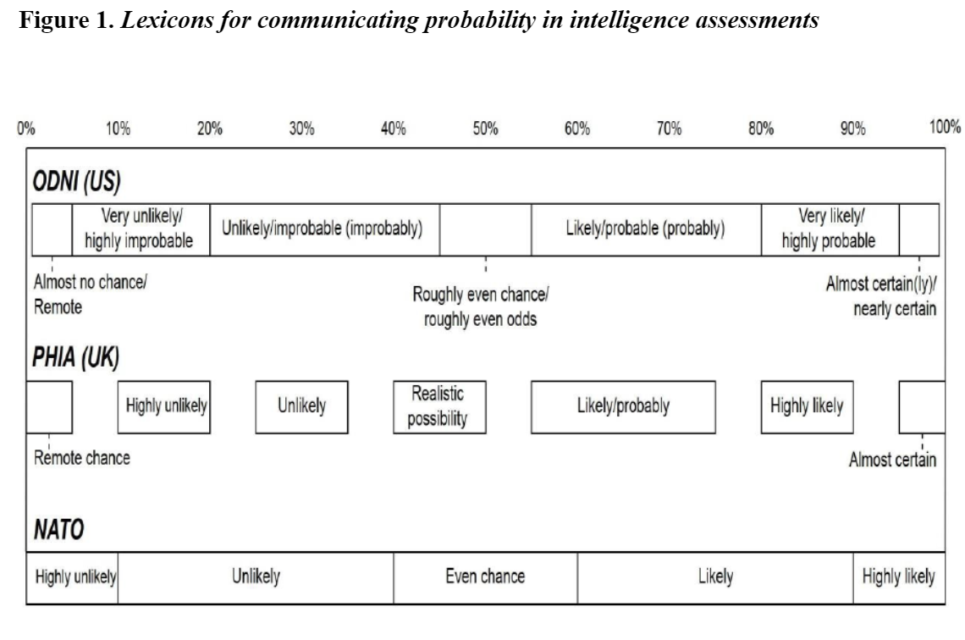
Communicating Probability Precisely
Notes:
The USG through ODNI now publishes an official lexicon for communicating probability in intelligence assessments. As seen on this slide it is now doctrine that a USG intel analyst who uses the term “very likely” means 80% or greater likelihood.
Depending on where you work it may be helpful to come up with your own criteria for communicating probability which could alternately look like just sharing the numerical assessment as opposed to using words as proxies. When possible, stick to clear language that will be understood with any audience and avoid ambiguous phrases (“we doubt”, “we believe”, “improbable”). When working with someone else’s intel, ask them for their standards if possible.

Slide 42
Guidelines for intelligence writing: short sentences
7. Be correct, credible, and complete
Correct: Grammar
Credible: State the assumptions on which your analysis rely
Complete: State the unknowns or gaps in your analysis

Slide 43
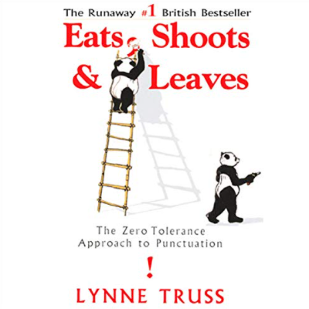
Correct Grammar
“It’s tough being a stickler for punctuation these days. One almost dare not get up in the mornings...Everywhere one looks, there are signs of ignorance and indifference...Part of one’s despair, of course, is that the world cares nothing for the little shocks endured by the sensitive stickler. While we look in horror at a badly punctuated sign, the world carries on around us, blind to our plight…” Eats Shoots & Leaves by Lynne Truss
Notes:
This is a graduate school class and as such I am sure many of the people in this room are competent writers but what I suspect more deeply is that most if not all of us are set in our writing ways. I know that I am. The challenge here is that being an above-average writer is an expectation of many intelligence roles. I have found in my career that this is one of the single hardest areas to coach someone on because improving your writing takes structured instruction and practice. This is not the goal of this course so instead I can just point you to a book which is legendary called “Eats Shoots & Leaves” by Lynne Truss.

Slide 44
State your assumptions
“Objectivity is gained by making assumptions explicit so that they may be examined and challenged, not by vain efforts to eliminate them from analysis.”
“Analysis begins when the analyst consciously inserts himself or herself into the process to select, sort, and organize information. This selection and organization can only be accomplished according to conscious or subconscious assumptions and preconceptions.”
“Analysts do not achieve objective analysis by avoiding preconceptions; that would be ignorance or self-delusion. Objectivity is achieved by making basic assumptions and reasoning as explicit as possible so that they can be challenged by others and analysts can, themselves, examine their validity.”
Richards Heuer
Notes:
For most analytical endeavors your analysis will be constrained in some way. That constraint may be due to time, funding, availability of data, etc. Therefore, you are going to have to make some decisions about what to prioritize. That process of prioritization is going to be underpinned by information and assumptions you have about how the analysis will proceed. It is important to call out explicitly important assumptions upon which your paper relies because, of course, if those assumptions are flawed then your paper may be useless.
Richards Heuer wrote “The Psychology of Intelligence Analysis” which is a seminal work which seeks to understand how humans conduct analysis and to propose structured models for how to do analysis work well. He swiftly does away with any notion that there is such a thing as being unbiased. He writes, “Objectivity is gained by making assumptions explicit so that they may be examined and challenged, not by vain efforts to eliminate them from analysis.”
“Analysis begins when the analyst consciously inserts himself or herself into the process to select, sort, and organize information. This selection and organization can only be accomplished according to conscious or subconscious assumptions and preconceptions.”
“Analysts do not achieve objective analysis by avoiding preconceptions; that would be ignorance or self-delusion. Objectivity is achieved by making basic assumptions and reasoning as explicit as possible so that they can be challenged by others and analysts can, themselves, examine their validity.”

Slide 45
State the unknowns or gaps in your analysis
“One’s attention tends to focus on what is reported rather than what is not reported. It requires a conscious effort to think about what is missing but should be present if a given hypothesis were true.”
“Analysts should identify explicitly those relevant variables on which information is lacking, consider alternative hypotheses concerning the status of these variables, and then modify their judgment and especially confidence in their judgment accordingly. They should also consider whether the absence of information is normal or is itself an indicator of unusual activity or inactivity.”
Richards Heuer
Notes:
Another component of intelligence writing is to state the unknowns or gaps in your analysis explicitly. I find that this runs counter to human nature to want to do. If you as the analyst but days, weeks, years into proving a particular point it feels really shitty to have to say “Despite all of this work and my firmly held view that X is the case, it could not be the case because this is the work I didn’t or couldn’t do. Or, these are the things I did which undercut my point.” It feels like you are owning up to a failure of some kind. An analyst must intentionally shift their mental approach to their own writing so instead of feeling ownership over the rightness or wrongness of a point it is more helpful to think “Is this all of the information on this topic? It never will be and so let me explain why I rationally chose X but not Y with recognition that Y could be important.”

Slide 46
Identify counter examples and lacking data
“Illusory correlation occurs when people perceive a relationship that does not in fact exist. In looking at a series of cases, it seems that people often focus on instances that support the existence of a relationship but ignore those cases that fail to support it. Several experiments have demonstrated that people do not have an intuitive understanding of what information is really needed to assess the relationship between two events or two variables. There appears to be nothing in people’s intuitive understanding that corresponds with the statistical concept of correlation.”
“The most likely hypothesis is usually the one with the least evidence against it, not the one with the most evidence for it.”
Notes:
Relatedly, as you do analysis it is natural to feel that proving a point equates to winning and disproving a point equates to losing. This may be a normal approach but it produces bad analysis. As Richards Heuer points out people are prone to focusing on instances that support the existence of a relationship while downplaying or ignoring cases that fail to support it. For this reason it is a good approach to set structured expectations for yourself and to quantify your analysis. For example, “ I am going to triage X number of samples and then I will review the output of that triage.” This way you must review all 100 samples and that way even if your first 20 reinforce your priors you do not stop your analysis which could then reveal that the next 80 do not support your conclusion.

Slide 47
Getting started with analysis
Analysis of Competing Hypotheses
Identify the possible hypotheses to be considered
Make a list of significant evidence and arguments for and against each
Prepare a matrix with hypotheses across the top and evidence down the side. Analyze the diagnosticity of the evidence and arguments
Refine the matrix. Reconsider the hypotheses and delete evidence that has no diagnostic value.
Draw tentative conclusions about the relative likelihood of each hypothesis. Proceed by trying to disprove the hypotheses rather than prove them.
Analyze how sensitive your conclusion is to a few critical items of evidence. Consider the consequences for your analysis if that evidence were wrong, misleading, or subject to a different interpretation.
Report conclusions. Discuss the relative likelihood of all the hypotheses not just the most likely one.
Identify milestones for future observation that may indicates events are taking a different course then expected.
Notes:
Know that when you start your analysis you will aid your ability to write well by crafting a good analytical question which will make it possible to draw a clear conclusion, back up your conclusion with facts, state the gaps, and defend the prioritization / tradeoffs.
One such mechanism to start crafting a good question is to do what Richards calls “Analysis of competing hypotheses.” This approach involves identifying a set of hypotheses, making a list of significant evidence (or possible evidence) and arguments for and against each, then documenting a matrix with hypotheses across the top and evidence down the side. This can serve as a forcing mechanism to be intentional about which question you pursue answering and force documentation of the counter-points.

Slide 48
Guidelines for intelligence writing: Know your audience
8. Know your audience.
Questions to consider:
Who are you writing for?
What style will they be used to seeing?
What information do you need to convey?
What style will best convey that information?

Slide 49
An example: Academic vs intel writing in practice
Academic
Using an established technique in the field, we examined files that had been submitted to the AV scanning service VirusTotal. We identified a sample that appeared to be designed to target individuals involved in the fashion industry (titled ‘so_hot_right_now.exe’. Upon further investigation, we identified additional evidence that the malware was designed to target the Prime Minister of Malaysia; the submitter ID that added the file to VT also submitted other documents related to the Malaysian government.
The malware sample beaconed to the a particular IP which also hosted the domain pianokeynecktie[.]tk; the inventor of the piano key necktie is a fashion mogul ‘Mugatu’ who we believe has reasons to target the Prime Minister of Malaysia. Based on these facts, we assess that this malware - and the actor group it is tied to, APT999 - has a nexus to Mugatu.

Slide 50
Academic writing includes expository content
Expository Content (note the order of retelling is chronological)
Using an established technique in the field, we examined files that had been submitted to the AV scanning service VirusTotal. We identified a sample that appeared to be designed to target individuals involved in the fashion industry (titled ‘so_hot_right_now.exe’. Upon further investigation, we identified additional evidence that the malware was designed to target the Prime Minister of Malaysia; the submitter ID that added the file to VT also submitted other documents related to the Malaysian government.
The malware sample beaconed to the a particular IP which also hosted the domain pianokeynecktie[.]tk; the inventor of the piano key necktie is a fashion mogul ‘Mugatu’ who we believe has reasons to target the Prime Minister of Malaysia. Based on these facts, we assess that this malware - and the actor group it is tied to, APT999 - has a nexus to Mugatu.
Key:
Expository

Slide 51
Academic writing glosses over technical data
Missing Technical Data
Using an established technique in the field, we examined files that had been submitted to the AV scanning service VirusTotal. We identified a sample that appeared to be designed to target individuals involved in the fashion industry (titled ‘so_hot_right_now.exe’. Upon further investigation, we identified additional evidence that the malware was designed to target the Prime Minister of Malaysia; the submitter ID that added the file to VT also submitted other documents related to the Malaysian government.
The malware sample beaconed to the a particular IP which also hosted the domain pianokeynecktie[.]tk; the inventor of the piano key necktie is a fashion mogul ‘Mugatu’ who we believe has reasons to target the Prime Minister of Malaysia. Based on these facts, we assess that this malware - and the actor group it is tied to, APT999 - has a nexus to Mugatu.
Key:
Expository
Technical Data

Slide 52
Academic writing presents broad strokes analysis
Analysis
Using an established technique in the field, we examined files that had been submitted to the AV scanning service VirusTotal. We identified a sample that appeared to be designed to target individuals involved in the fashion industry (titled ‘so_hot_right_now.exe’. Upon further investigation, we identified additional evidence that the malware was designed to target the Prime Minister of Malaysia; the submitter ID that added the file to VT also submitted other documents related to the Malaysian government.
The malware sample beaconed to a particular IP which also hosted the domain pianokeynecktie[.]tk; the inventor of the piano key necktie is a fashion mogul ‘Mugatu’ who we believe has reasons to target the Prime Minister of Malaysia. Based on these facts, we assess that this malware - and the actor group it is tied to, APT999 - has a nexus to Mugatu.
Key:
Expository
Assessment
Technical Data

Slide 53
Academic writing may use arbitrary estimative language
Arbitrary Estimative Language
Using an established technique in the field, we examined files that had been submitted to the AV scanning service VirusTotal. We identified a sample that appeared to be designed to target individuals involved in the fashion industry (titled ‘so_hot_right_now.exe’. Upon further investigation, we identified additional evidence that the malware was designed to target the Prime Minister of Malaysia; the submitter ID that added the file to VT also submitted other documents related to the Malaysian government.
The malware sample beaconed to a particular IP which also hosted the domain pianokeynecktie[.]tk; the inventor of the piano key necktie is a fashion mogul ‘Mugatu’ who we believe has reasons to target the Prime Minister of Malaysia. Based on these facts, we assess that this malware - and the actor group it is tied to, APT999 - has a nexus to Mugatu.
Key:
Expository
Assessment
Estimative Language
Technical Data

Slide 54
Academic writing mixes facts amidst expository content
Facts
Using an established technique in the field, we examined files that had been submitted to the AV scanning service VirusTotal. We identified a sample that appeared to be designed to target individuals involved in the fashion industry (titled ‘so_hot_right_now.exe’. Upon further investigation, we identified additional evidence that the malware was designed to target the Prime Minister of Malaysia; the submitter ID that added the file to VT also submitted other documents related to the Malaysian government.
The malware sample beaconed to a particular IP which also hosted the domain pianokeynecktie[.]tk; the inventor of the piano key necktie is a fashion mogul ‘Mugatu’ who we believe has reasons to target the Prime Minister of Malaysia. Based on these facts, we assess that this malware - and the actor group it is tied to, APT999 - has a nexus to Mugatu.
Key:
Expository
Assessment
Estimative Language
Facts
Technical Data

Slide 55
Rewritten as an intelligence product
Key:
Expository
Assessment
Estimative Language
Facts
Technical Data
We assess with high confidence that APT999 is affiliated with Mugatu, with their most recent campaign targeting the Prime Minister of Malaysia.
We obtained a malware sample (1bd4f4743bed16314b32f828c23427ed, ‘so_hot_right_now[.]exe’).
Passive DNS records indicate that at the same time the executable was compiled (09/10/21), the C2 server (8[.]8[.]8[.]8) also hosted the domain pianokeynecktie[.]tk.
The file was uploaded to VirusTotal from a submitter ID (#12345) that previously uploaded files specific to the office of the Prime Minister of Malaysia.
The inventor of the piano key necktie is Mugatu, a fashion mogul known for coining the expression ‘so hot right now’; we’ve previously assessed his risk to the Prime Minister of Malaysia (see report #####).

Slide 56
Concepts to review from this session
New Data Types Fundamental Python constructs that define how data is stored and what can be done with it. | str()
New Concepts Ideas, concepts, or other abstract processes for working with code. | Applying Math & Comparison Operators to Strings Soft Introduction: Iterables Indices
New Operators Python foundational operators that take action on data. | : when used as a slice operator
New Keywords / Expressions Reserved keywords, statements, expressions, or other constructs for manipulating data. | Slice Notation (aka [start:stop:step])
New Functions Python’s general purpose way to call code to complete specific tasks | len() chr() ord()
New Methods Code that belongs to specific object types that can be called on objects of the appropriate type. | str.lower() str.upper() str.strip()

